Slide 1
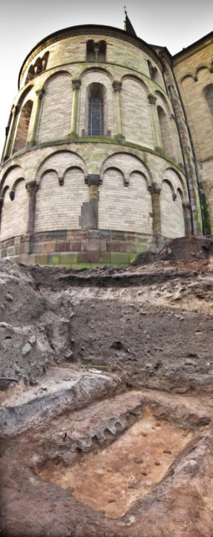
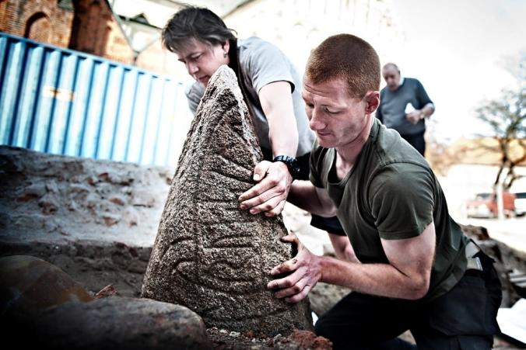
Ansgar’s church in Ribe
– The Viking Age cemetery underneath the cathedral
Converting Landscapes Colloquium, Bangor University, 22-23 March 2013
Morten Søvsø, Head of Archaeology, Sydvestjyske Museer

Slide 2
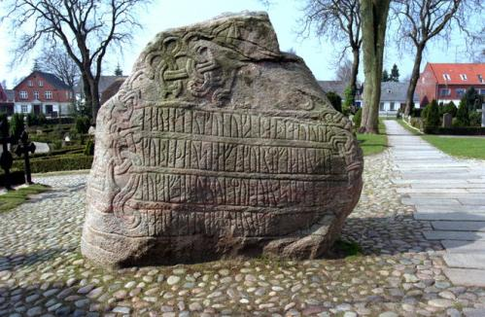
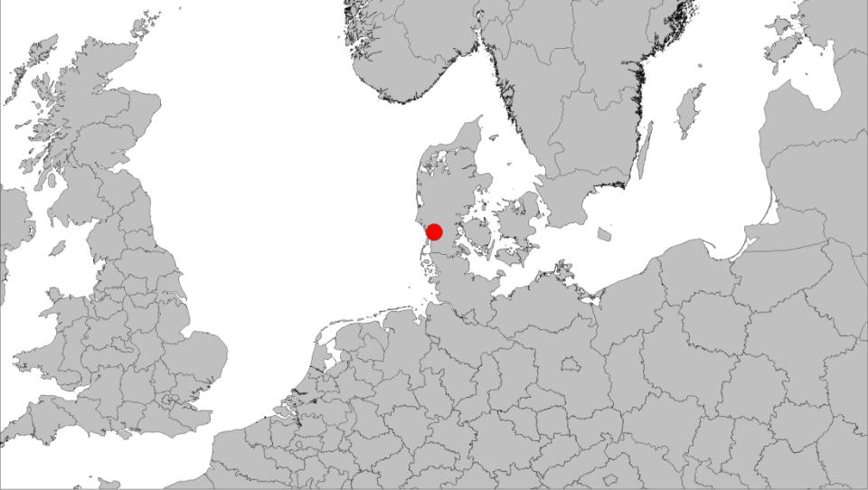
Northern Europe 800-850
Birka
Kaupang
Pagans
Christians
Ribe
Åhus
Truso
Hedeby
Reric
Hamburg
Ipswich
Bremen
Lundenwic
Dorestad
Hamwic
Corvey
Domburg
Quentovic
Corbie
Notes:
Ansgar fødes omkring år 800 O. 805 optages han i klosteret i Corbie efter sin mors død 823 forflyttes han til nystiftede Corvey, som leder af klosterskolen 829 missionsrejse til Norden. Kirke opføres på Birka.
831 Ærkesædet Hamburg grundlægges som missionssæde. Ansgar biskop

Slide 3
Ribe was founded c. 700.
Wic-type marketplace until c. 850
Ribe
Åhus
Truso
Frisians
Reric
Ipswich
Lundenwic
Dorestad
Hamwic
Domburg
Quentovic
Corbie

Slide 4
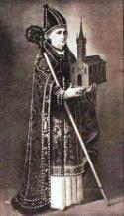
Northern Europe 800-850, Ansgars livsløb
Birka
826-27
Kaupang
Pagans
Christians
Ribe
Åhus
Truso
Hedeby
Reric
Hamburg
Ipswich
Bremen
Lundenwic
Dorestad
Hamwic
Corvey
Domburg
Quentovic
Corbie
Notes:
Ansgar fødes omkring år 800 O. 805 optages han i klosteret i Corbie efter sin mors død 823 forflyttes han til nystiftede Corvey, som leder af klosterskolen 829 missionsrejse til Norden. Kirke opføres på Birka.
831 Ærkesædet Hamburg grundlægges som missionssæde. Ansgar biskop

Slide 5
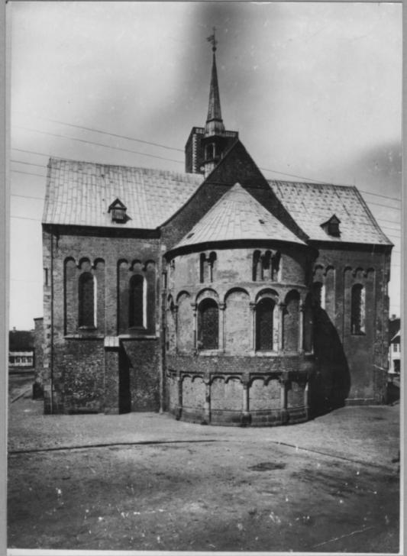
Before 1882
Prior to restoration works

Slide 6
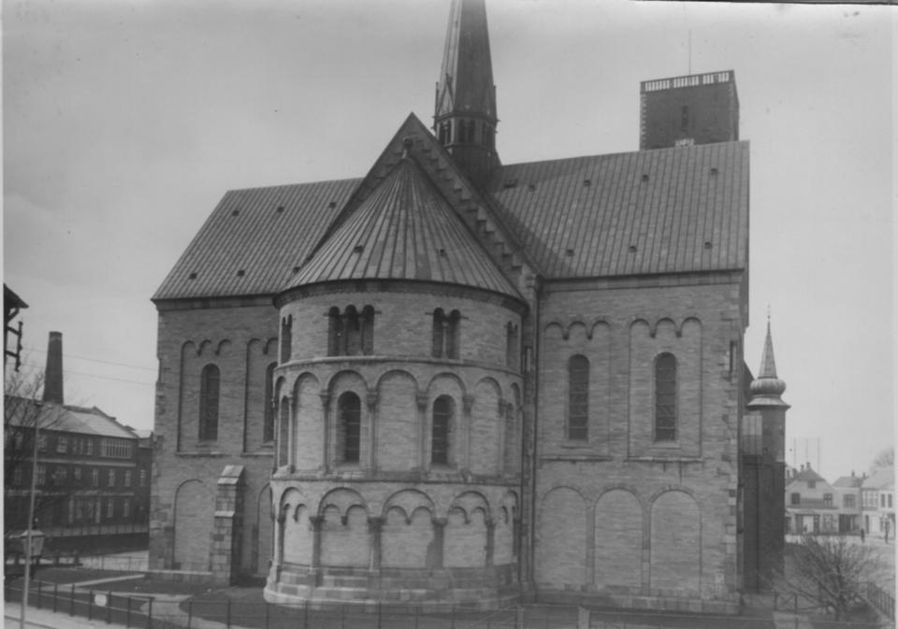
After restoration works
1-1½ meters was dug away around the cathedral

Slide 7
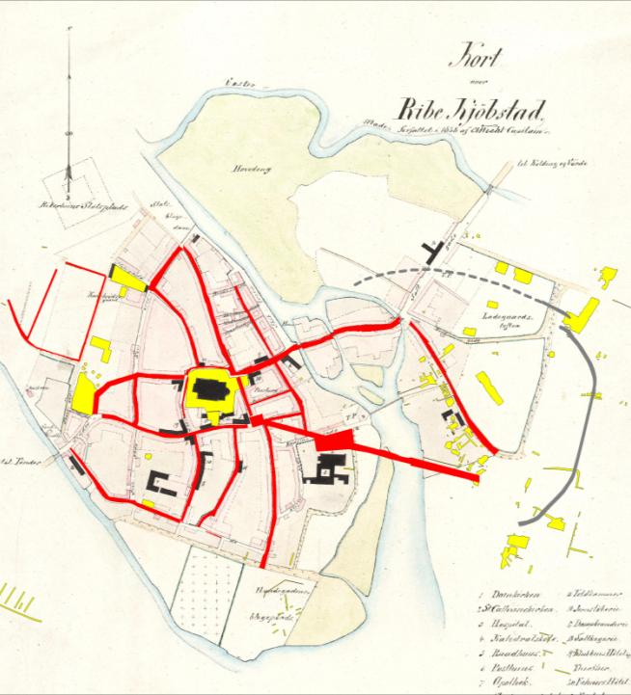
8.-9. C. Ribe

Slide 8
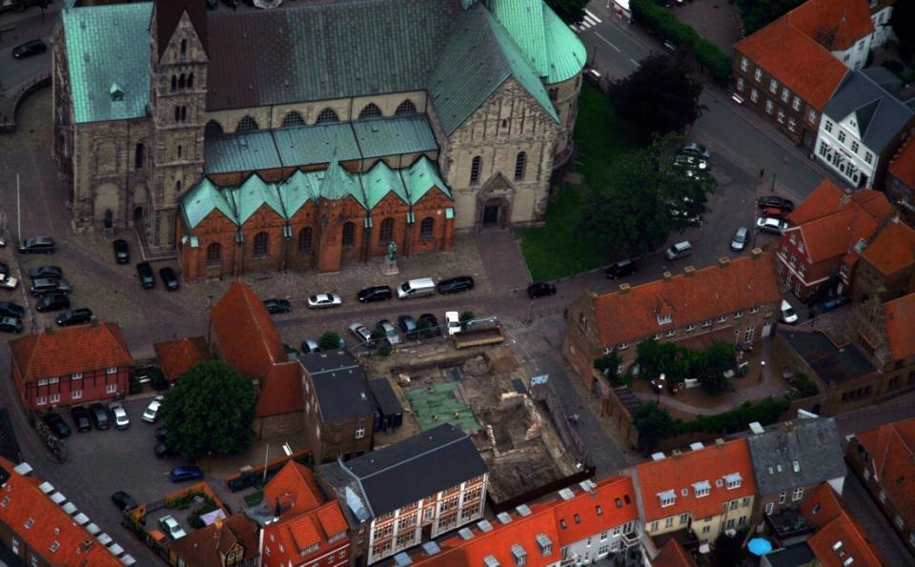
Excavations around the cathedral
1986
2012
1995
2011/12
2008/09
1987

Slide 9
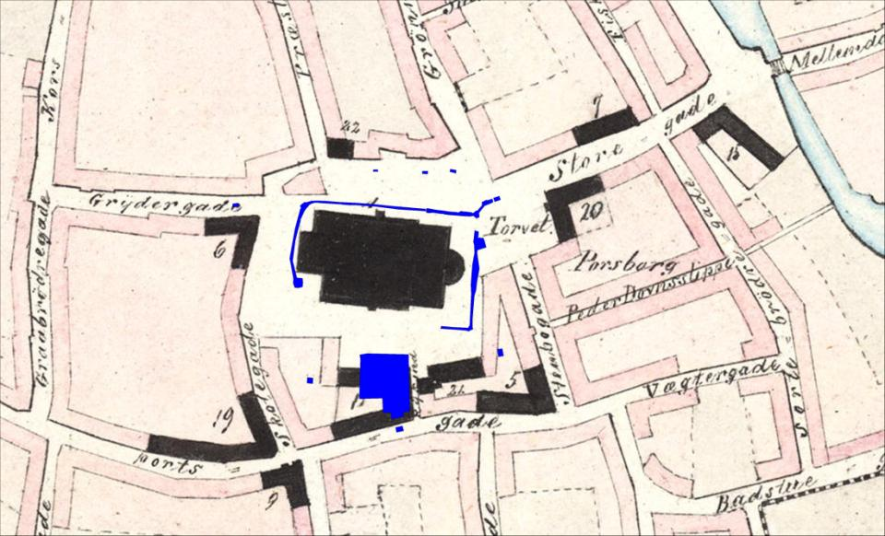
The original topography,
2006
2008-12
1995
1987
2004

Slide 10
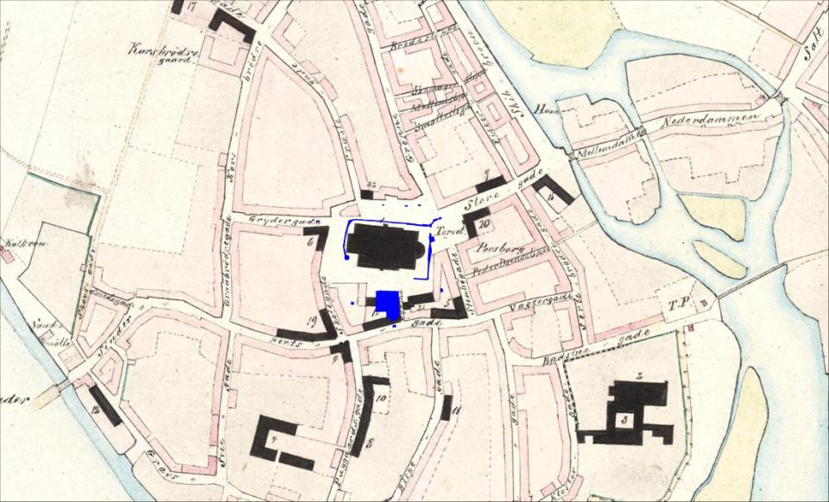
The original topography

Slide 11
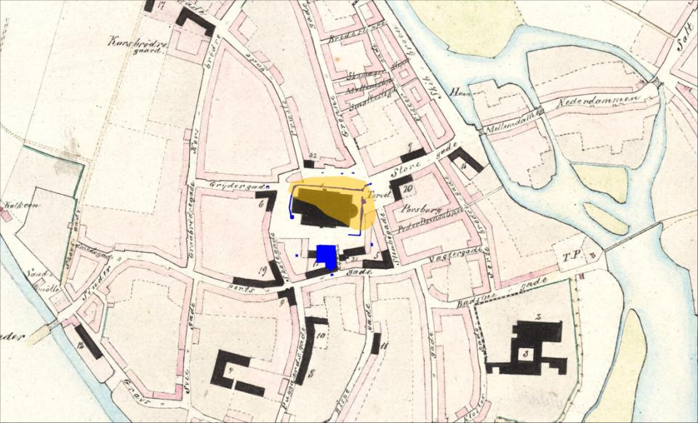
A dune of drift sand reaching c. 4 m ASL.

Slide 12
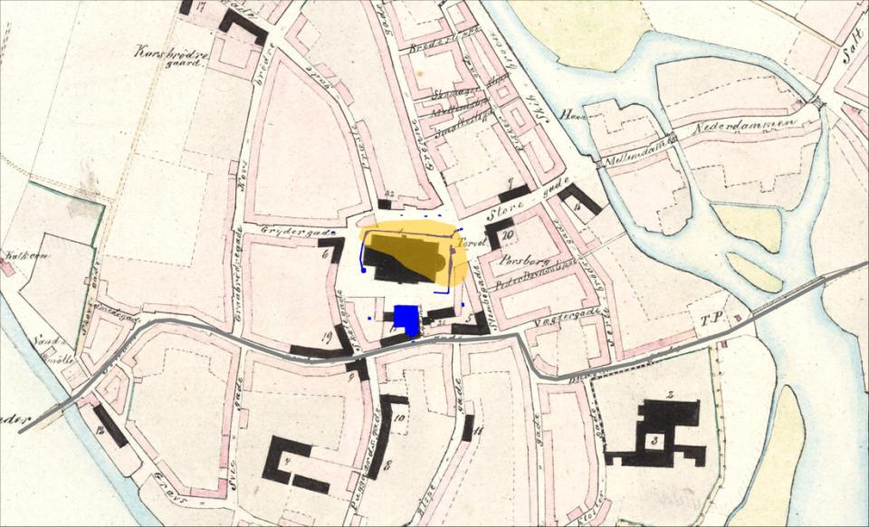
Church placed on a natural terrace c. 1½ meters above the old main road.

Slide 13
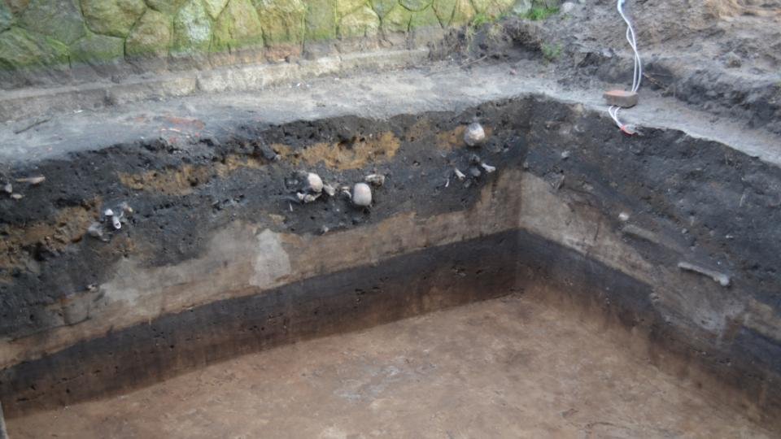
The original topography
Truncation level 1890
Medieval burials
Drift sand, c. 0 AD
Original topsoil, contained flints
Viking Age burial
Post Ice Age, melting sand

Slide 14
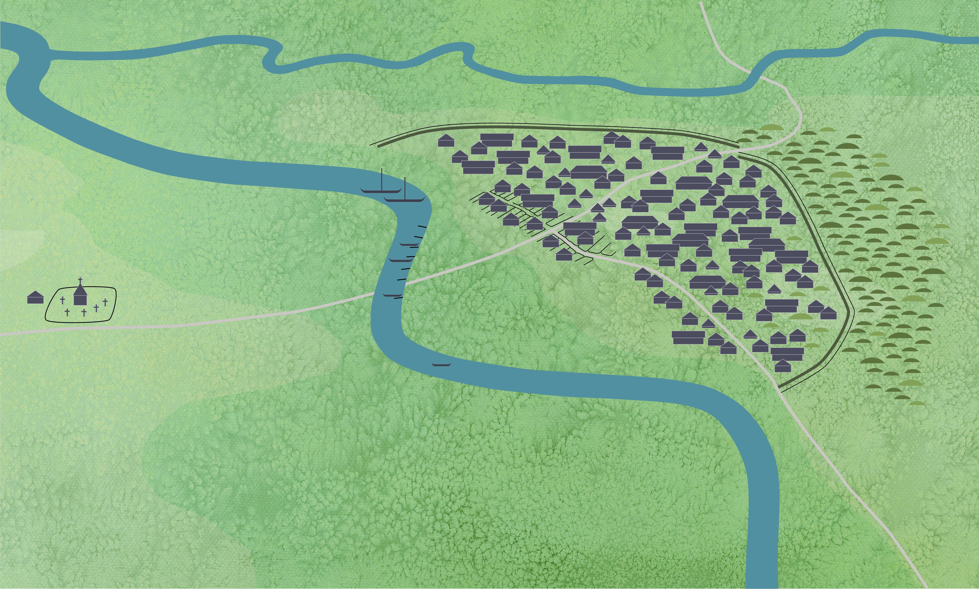
Ribe c. 860

Slide 15
The Lindegården excavation
1986
1995
1987

Slide 16
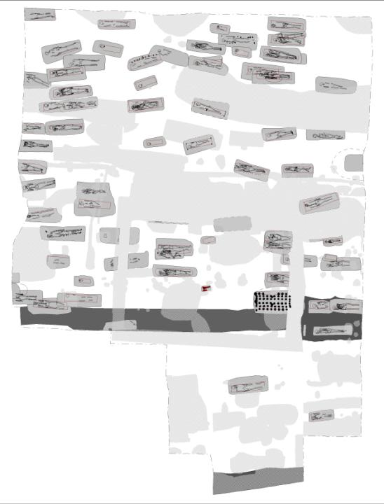
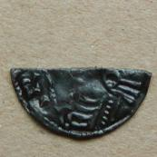
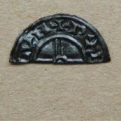
ASR 13
Lindegården
The Viking Age cemetery
82 graves excavated.
N
N
½ mønt. Knud d. Store, London, 1029-35.

Slide 17
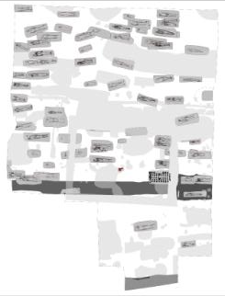
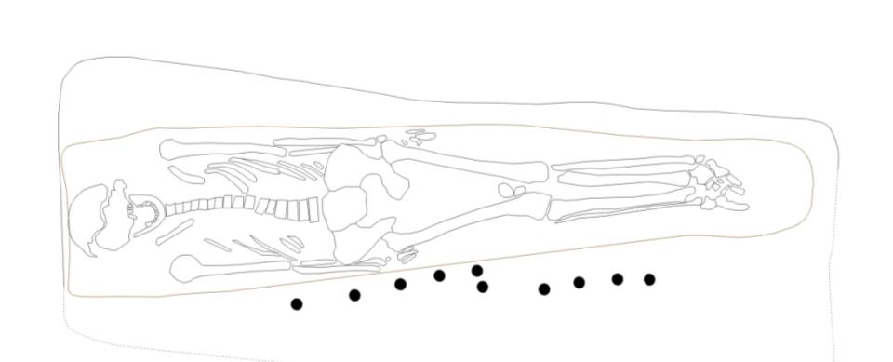
K1132
Female, Age 40-50 years, 155 cm. buried in bow of logboat
14C:11. C.

Slide 18
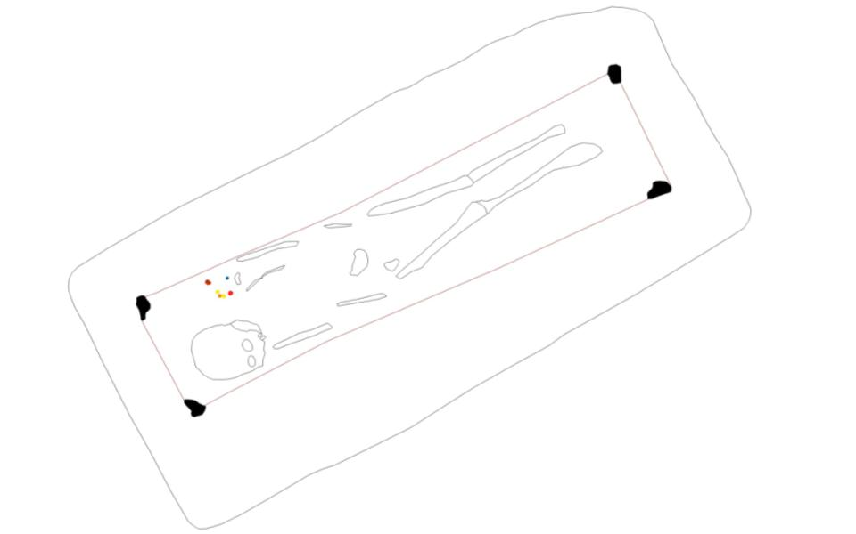
K1133. Age 5-7 years, 115 cm. Coffin with iron nails.

Slide 19
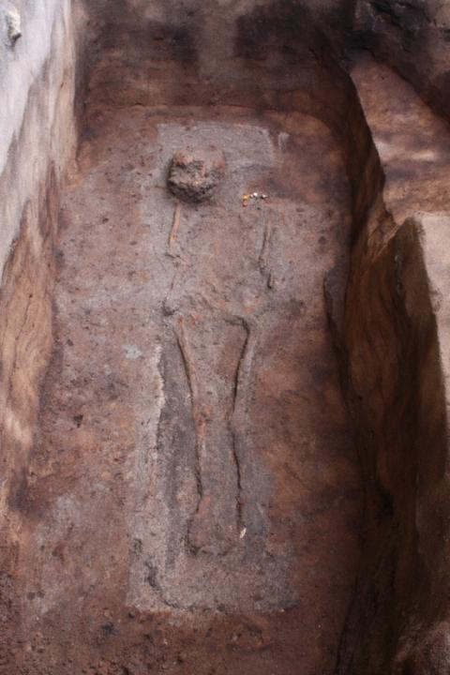
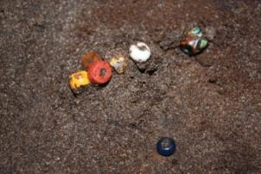
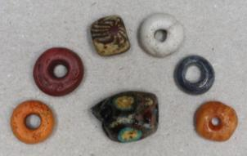
K1133
7 glass beads, an amber bead and decomposed silver bead. Probably 10. C.
No 14C

Slide 20
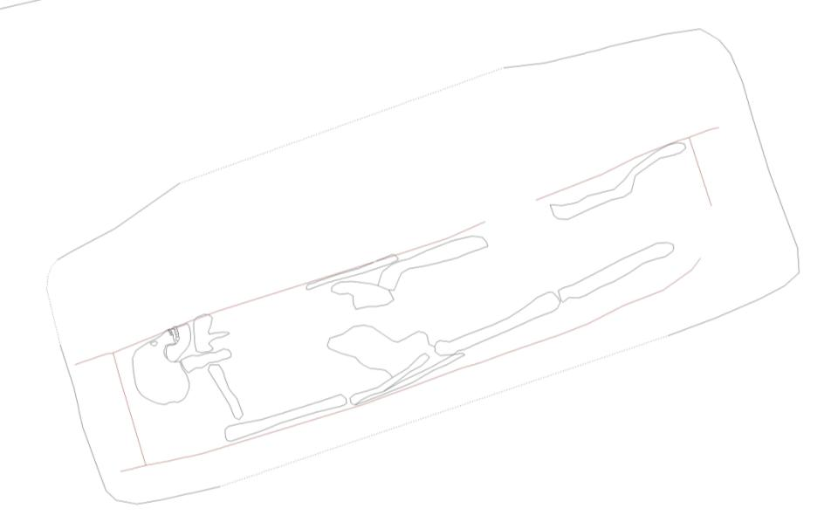
K1135. Man 35-45 years, c. 165 cm. Wooden coffin.

Slide 21
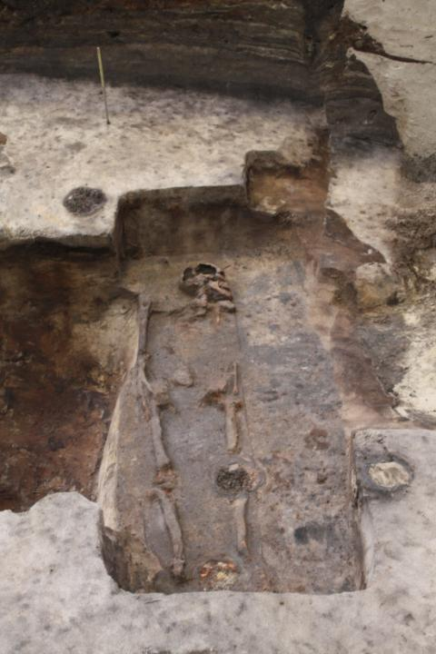
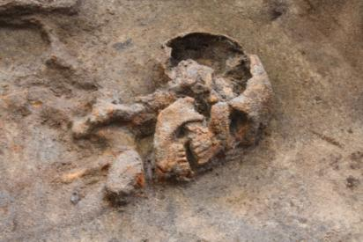
K1135
Poor preservation.
14C: 9. C.

Slide 22
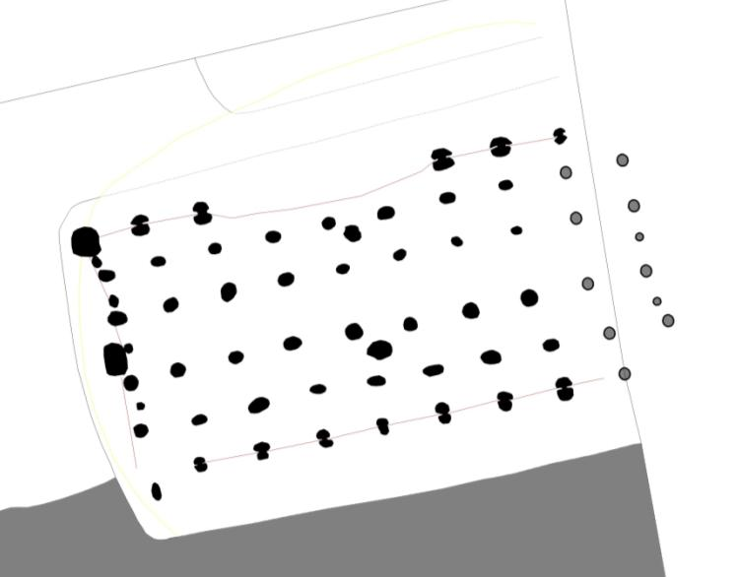
K1140. An emptied wagon-body-coffin, prob. 10. C.

Slide 23
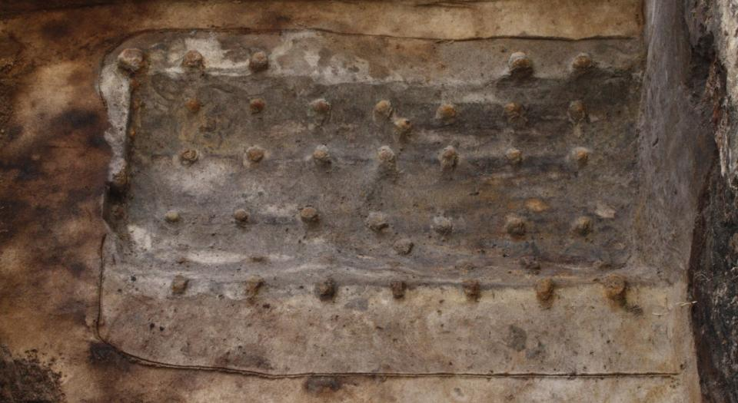
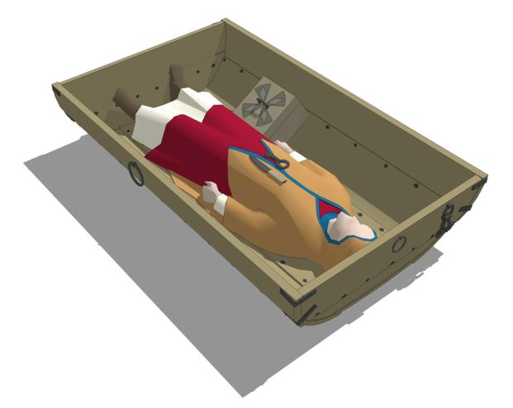
K1140. Typically High-status female grave form.
Perhaps reburied at another church?

Slide 24
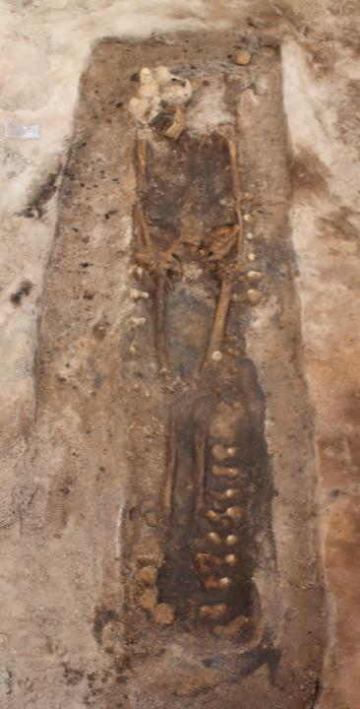
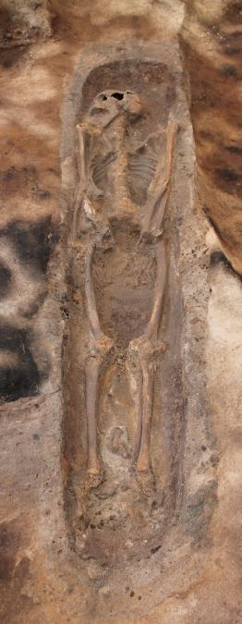
Coffin types
Coffin made from reused boat parts?
Log coffin

Slide 25
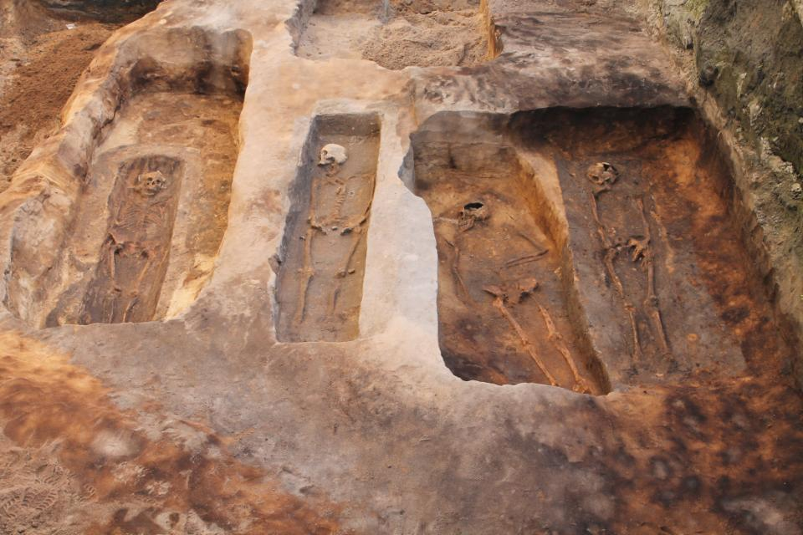
In most of the graves rectangular coffins
A few examples of log coffins and coffins from reused materials.
Strictly christian grave custom with only a few deviations.

Slide 26
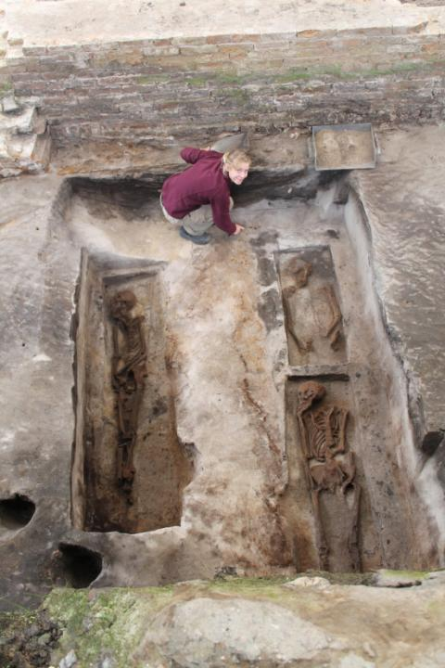
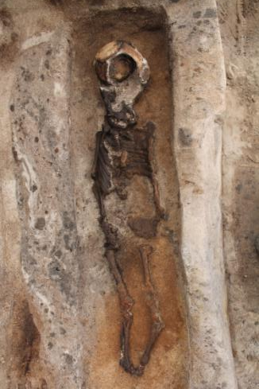
Both men, women and children were buried

Slide 27
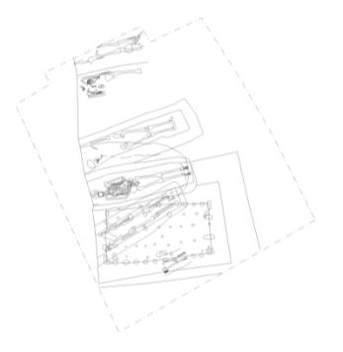
Viking graves east of the cathedral

Slide 28
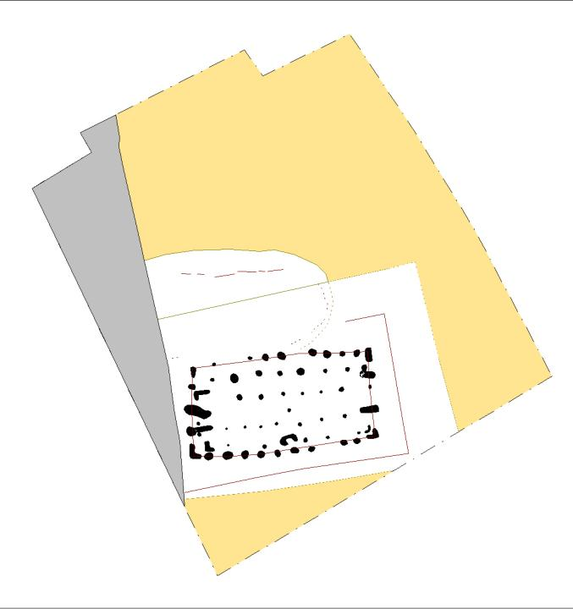
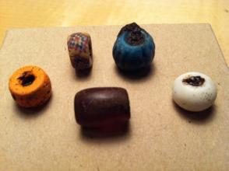
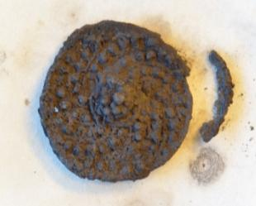
The two oldest graves were chamber graves

Slide 29
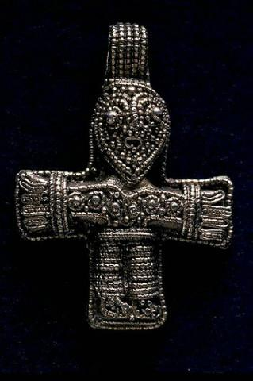
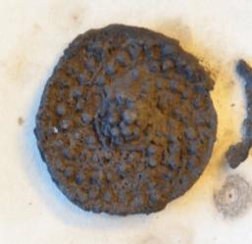
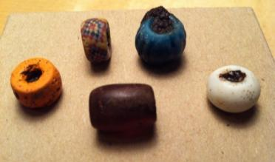
Shield amulet
Silver filigree
10. C.

Slide 30
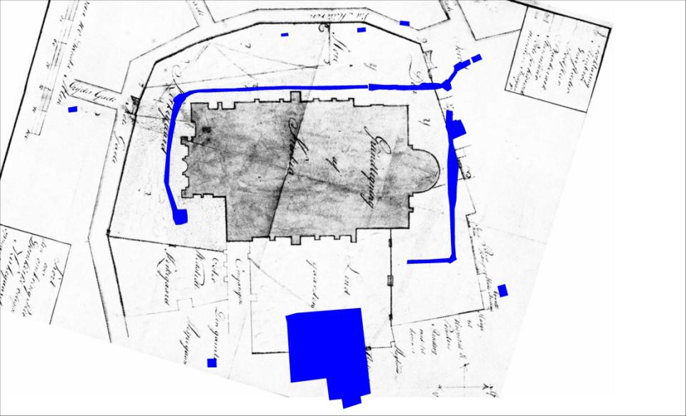
The extent of ”Ansgar’s cemetery”

Slide 31
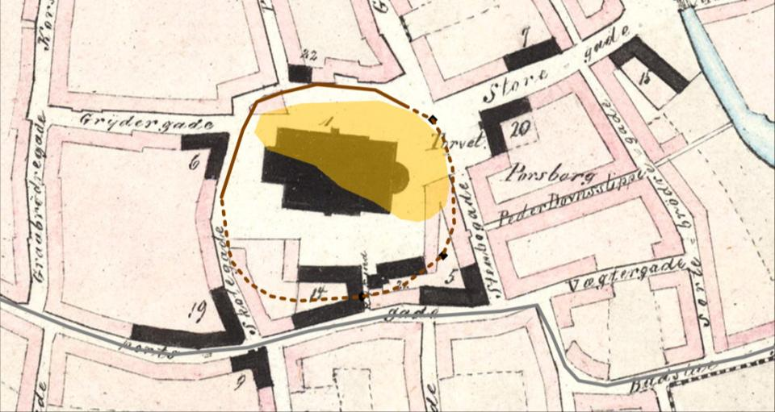
Circular cemetery bounded by a ditch
c. 10.000 m²
Number of buried, 850-1050: 2-30000

Slide 32
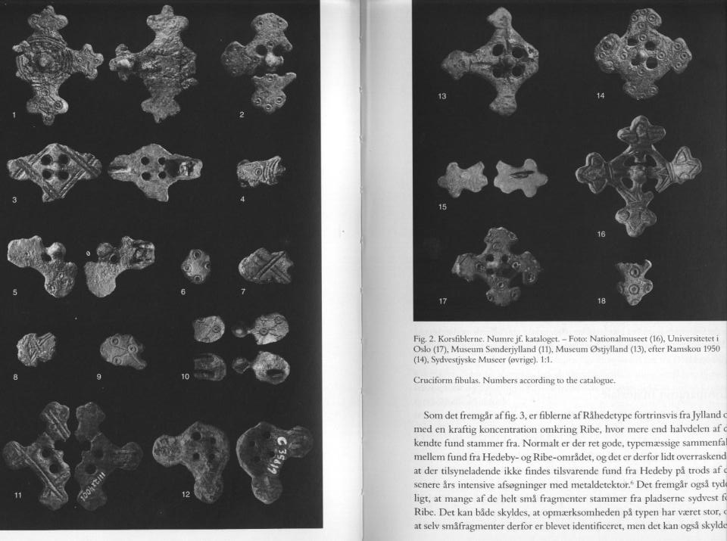
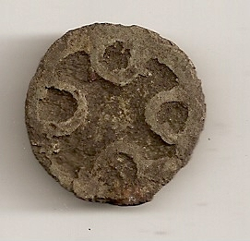
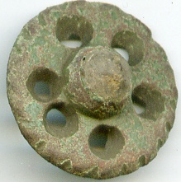
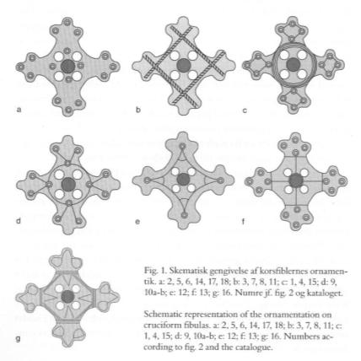
Cruciform fibulae made in/around Ribe
Found in closed archaeological context in Ribe from c. 850

Slide 33
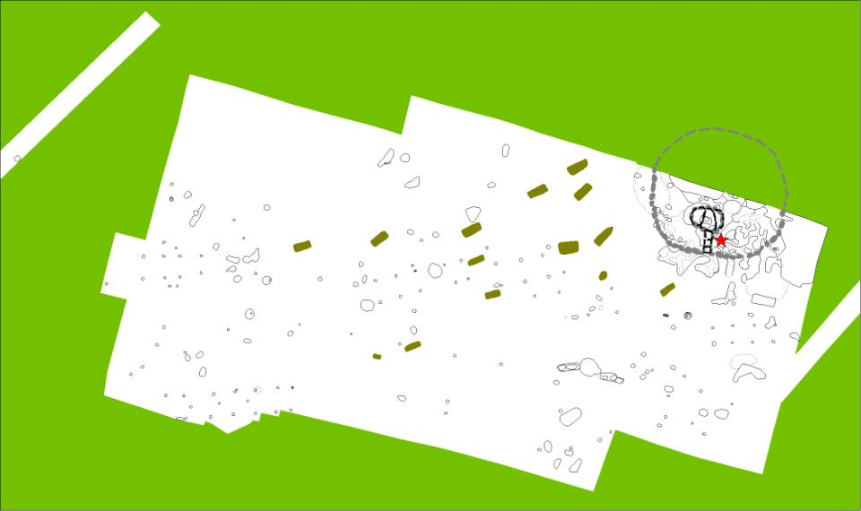
Nørlundvej, Hunderup. 10 km north of Ribe. 10. C. grave field.

Slide 34
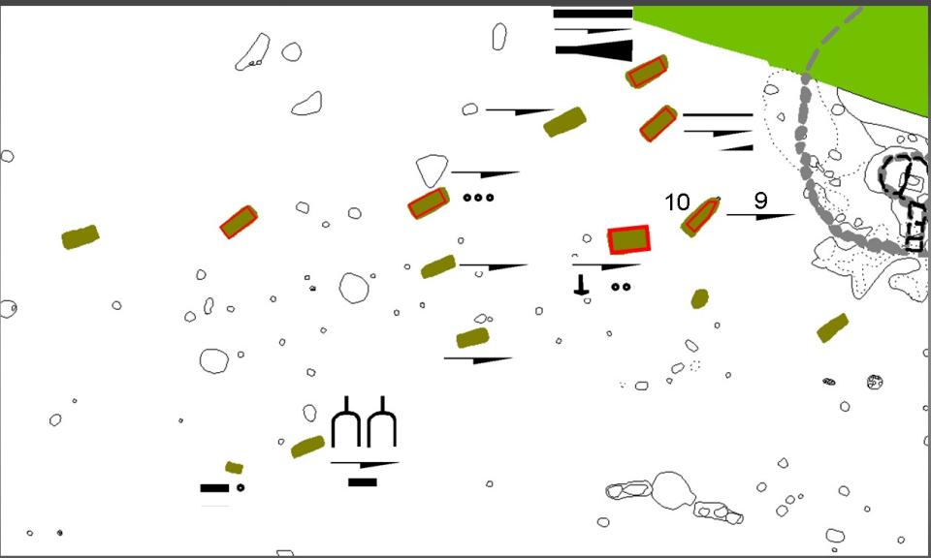
Grave goods. They were not christian.

Slide 35
But those buried here were.

